Slide 1

FITRE: Fisher Informed Trust-region Method for Training Policy Networks
Jan. 2021

Slide 2
What is FITRE?
FITRE is a high order optimizer which can be used in training deep neural networks
Advantages of FITRE
Fewer tuning parameters
Fewer steps to reach higher reward
Scalable to large problem

Slide 3
Tools used in FITRE: Natural Gradient
FITRE uses natural gradient to decide update direction
Why natural gradient is better?
Traditional gradient used in SGD is w.r.t. parameters, implemented in parameter space
Natural gradient is w.r.t. policy distribution, implemented in policy distribution space
Optimizing loss using different policy distributions is more meaningful than using different parameters
Implementation
Find Fisher matrix which is used in natural gradient
Use K-FAC to approximate Fisher matrix
Notes:
TRPO uses Lagrangian duality + back tracking to find natural gradient, using conjugate gradient to avoid inverse of Hessian
ACKTR uses the same method as FITRE in finding natural gradient

Slide 4
Implementation techniques
FITRE uses trust-region method to decide update step size
Why trust region is better?
Vanilla policy gradient uses small step size to avoid collapse
Trust-region method takes the largest possible step size
Trust-region method is more efficient
Implementation
Decide a trust region in which the difference of policy distributions is constrained
Inside the trust region, takes the largest possible step size
Notes:
ACKTR uses a different trust region method to update stepsize

Slide 5
FITRE for reinforcement learning
Modifications made to apply FITRE on reinforcement learning
Original FITRE algorithm is designed for supervised learning
We modified the algorithm to support reinforcement learning
FITRE now supports both continuous and discrete models

Slide 6
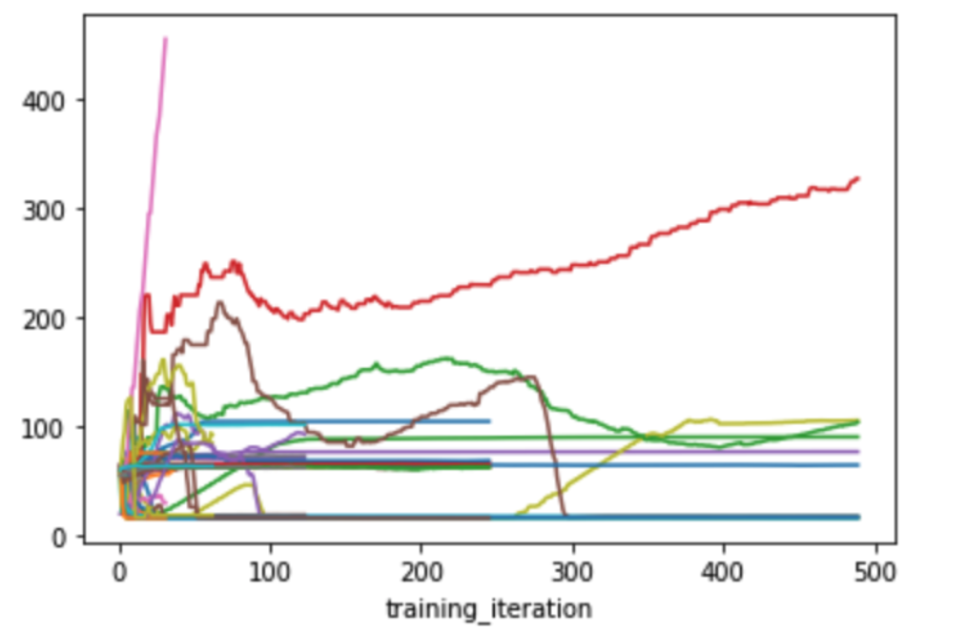
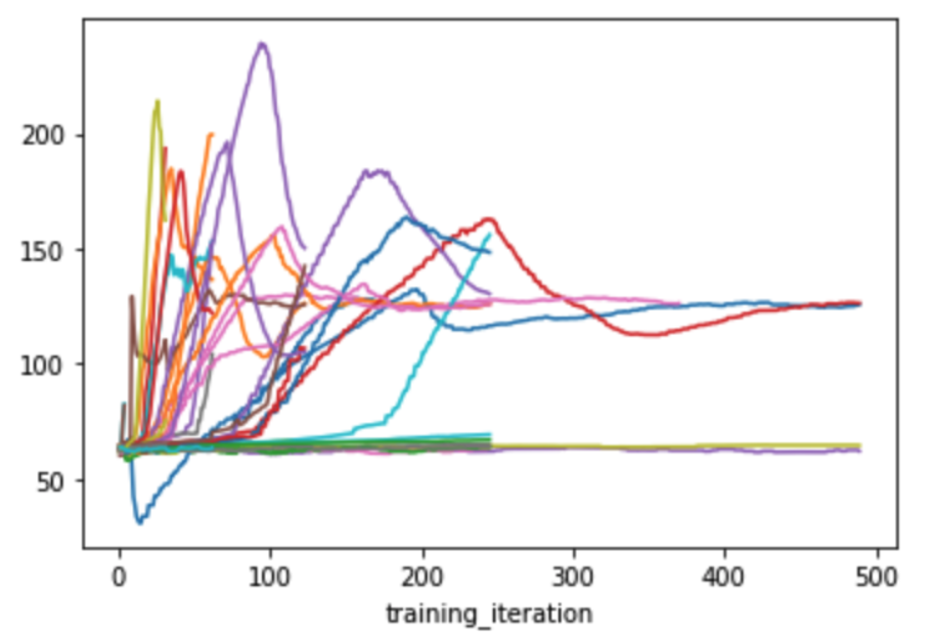
Results on F16 model
We run 50 trials for different optimization methods. Each trajectory in the plot shows rewards of one trial at different iterations. The higher the reward the better.
FITRE plot
Compare to PPO
FITRE: highest reward is around 450 achieved within about 30 iterations (pink trajectory)
PPO: highest reward is around 280 achieved within about 90 iterations (purple trajectory)

Slide 7
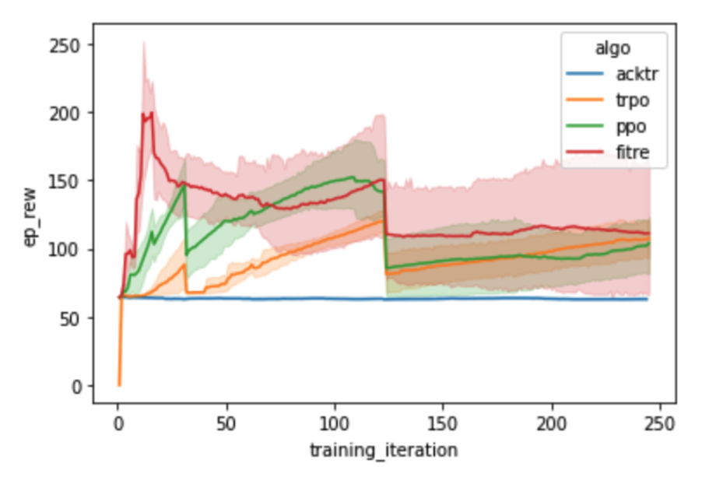
Conclusion
Top 5 plot of different methods
Compare to other methods
FITRE achieved highest reward
FITRE used fewest iterations to achieve its highest reward
In the above plot, the solid trajectory represents the mean of top five rewards of each algorithm, while the shade represents derivation.

Slide 8
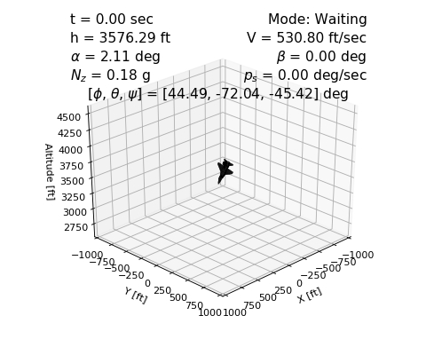
Simulation
The following is a 15 seconds simulation of the F16 model. The plane is controlled by a neural network trained by FITRE.
F16 Simulation
Notes:
Compare to the simulation of PPO, FITRE is much better as it pulls up earlier at a higher altitude.

Slide 9
Thank you
Q & A

